Slide 1
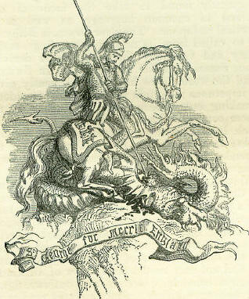
ST GEORGE’S DAY
BUDAPEST 2011
Notes:
This is an edited version of a short presentation given at the British Chamber of Commerce in Budapest St George’s Day Gala Dinner, April 2011.

Slide 2
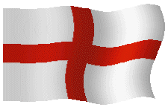
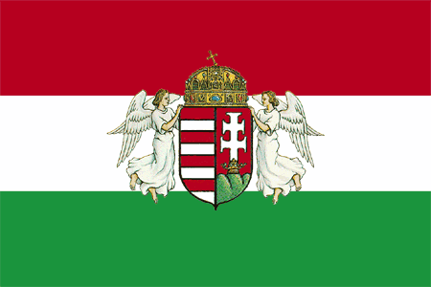
The English
in Hungary
Notes:
Having spoken about St George himself for the past 2 years, I thought I would use this opportunity to commemorate England’s patron saint by telling the stories of some famous and less well-known Englishmen and Englishwomen who were particularly associated with Hungary.

Slide 3
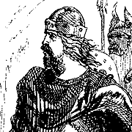
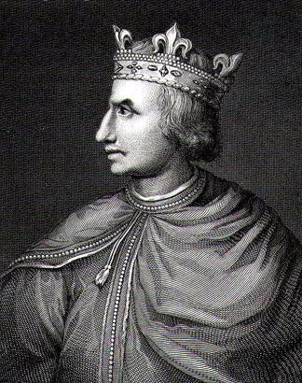
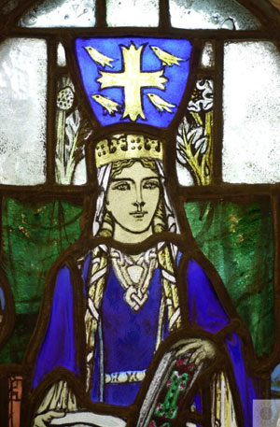
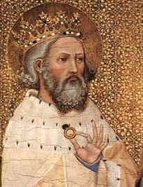
Edward the Exile
Notes:
As early as the first half of the eleventh century we find English guests at the Hungarian royal court. When Edward Ironside, King of Wessex, was murdered in 1016, his successor Canute banished Edward’s sons. 40 years later the ageing, childless Edward the Confessor learned that one of them, his nephew Edward the Exile, was living in Hungary where he had married the daughter of King St. Stephen. In 1057 he invited him home and 48 hours later Edward was dead. Edward’s daughter, St. Margaret, became the wife of King Malcolm of Scotland.

Slide 4
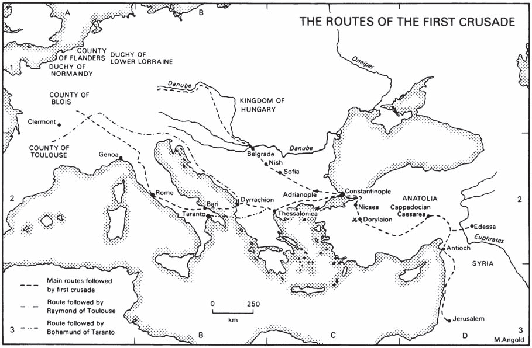
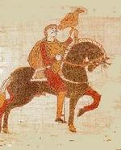
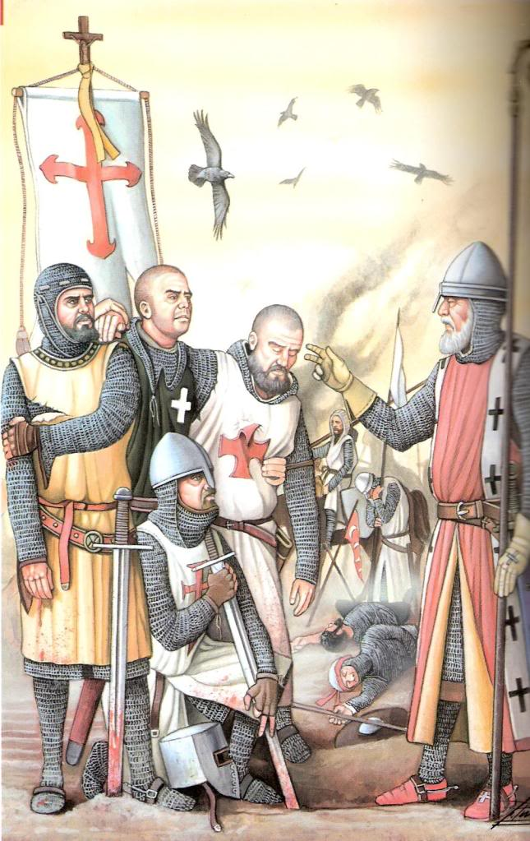
Alfred of Worcester, the Crusading Bishop
Notes:
Already in those days the shortest, safest route to the Near East led through Hungary. It was along this road that in the eleventh century the pilgrims passed back and forth and where, in 1058, Aldred Bishop of Worcester came crusading on behalf of Edward the Confessor. He was the first, but not the last Bishop to do so. He may have passed through Hungary to assist Edward the Exile’s family to come back to England or possibly to seek for other potential heirs of his. Crusaders of course wore the red crosses of St George, which made them fantastic targets on the battlefield.

Slide 5
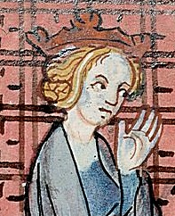
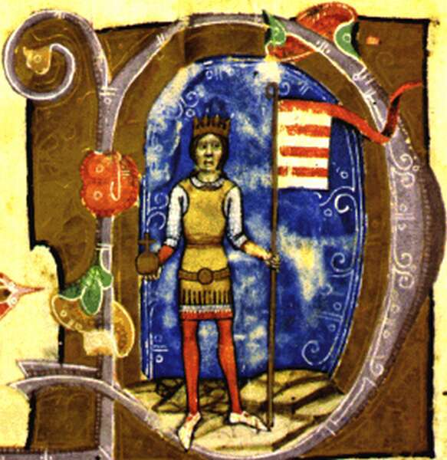
Margaret Capet
Notes:
Margaret Capet was the widow of the son of King Henry II, “Henry the Young King”, to whom she had been married at the ripe old age of 2. But in 1186 Béla III of Hungary took as his second wife. The Angevin kings of Hungary were related to the English royal house. As a result of travellers’ tales there developed in English minds a picture of Hungary as a far-away, fabulously rich country. Medieval chronicles and ballads refer with awe and wonder to the powerful Kings of Hungary and to a land flowing with milk and honey. Margaret probably had a major role in promoting the cult of Thomas a Becket in Hungary at that time and sponsoring his shrine in Esztergom.

Slide 6
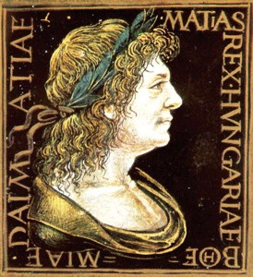
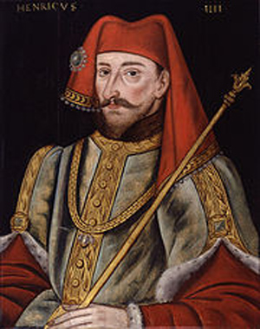
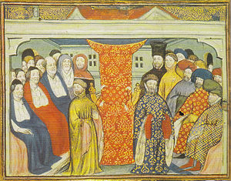
Henry IV
Notes:
At the end of the 14th Century and at the time of the Turkish advance into Europe, Henry Bolingbroke, the future King Henry IV, came to investigate the possibilities of a war of defence and met King Sigismund. In those days the King of Hungary was at the height of his power, and the kings of England and France solicited his intervention as ruler of the Holy Roman Empire. Sigismund accepted the role of peacemaker and in 1415 spent 4 months in England. Later, King Matthias sent envoys to the court of King Henry IV.

Slide 7
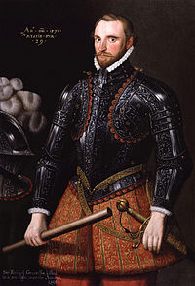
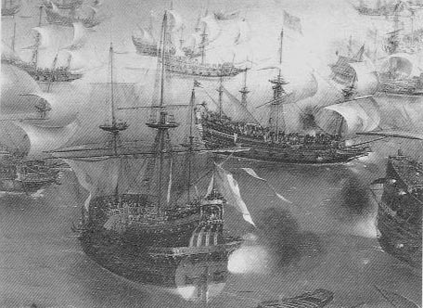
Richard Grenville
Notes:
In 1566 we find Sir Richard Grenville – the sea captain and explorer – gaining early military experience and fighting against Suleiman the Magnificent in Hungary. This was 25 years before his death when fighting the forces of Philip II of Spain when in charge of HMS Revenge.

Slide 8
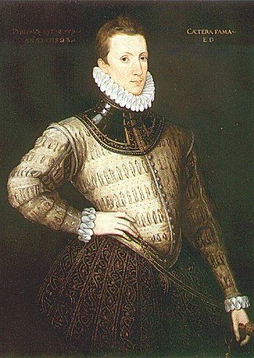
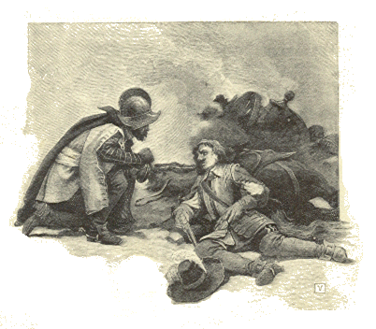
Sir Philip Sidney
Notes:
In Elizabethan literature the Hungarians were repeatedly mentioned in one form or another. Sir Philip Sidney who, having visited Vienna, extended his tour to Hungary in 1573, wrote: "In Hungary I have seen it the manner at all Feasts, and other such meetings, to have songes of their Ancestors' valour; which that right souldier-like Nation thinck the chiefest kindlers of brave courage". This was the first recorded English appreciation of Hungarian literature and valour. Sir Philip is especially famous for his death from wounds received at the Siege of Zutphen in 1586, when he gave his water bottle to another soldier saying “thy necessity is yet greater than mine”.

Slide 9
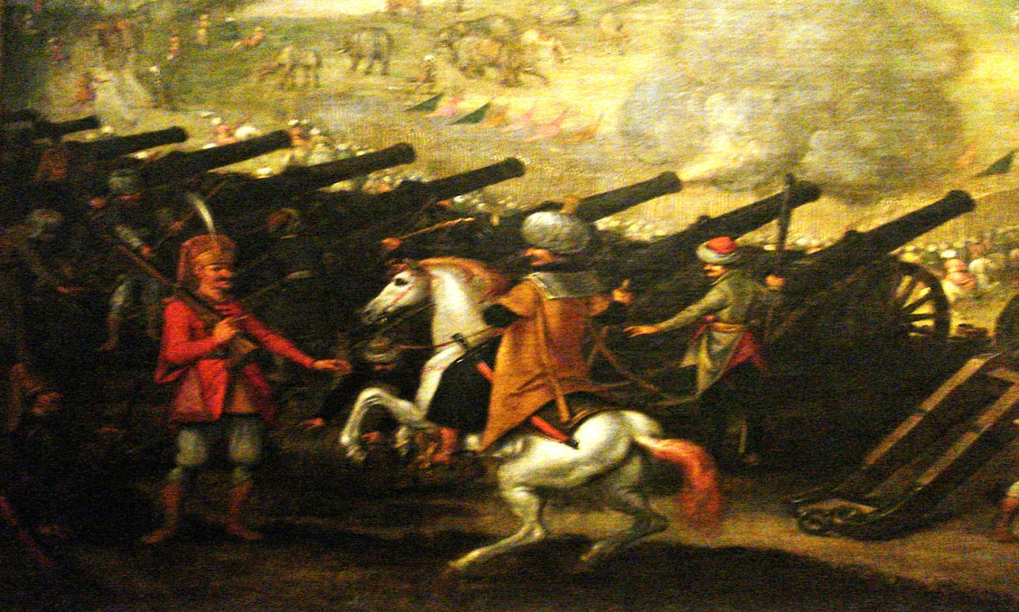
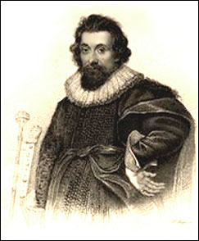
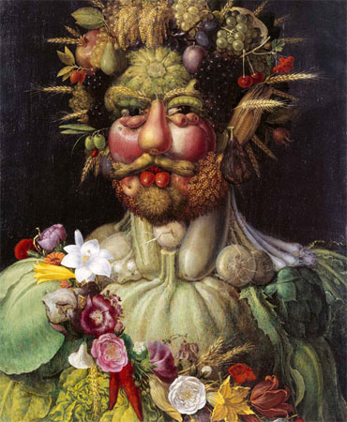
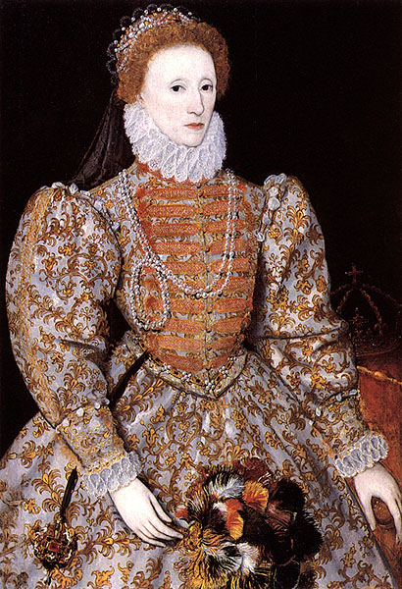
Thomas Arundel
Notes:
Next was Sir Thomas Arundell, a great favourite of Elizabeth I’s. He won glory in the Imperial service and at the storming of Esztergom in 1595 he forced the water tower and captured the enemy’s banner with his own hand. Rudolf II then made him Count of the Holy Roman Empire. His flaunting of this title annoyed the English nobility on his return, inspiring the Queen to send him to the Fleet prison for a spell and to say “my dogs shall wear no collar but my own”. To this day, British diplomats are not allowed to accept foreign honours.

Slide 10
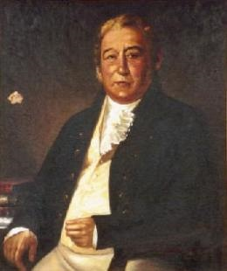
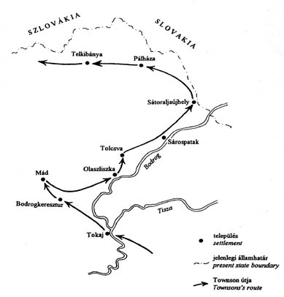
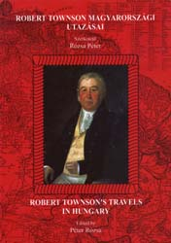
Robert Townson
Notes:
Here we skip over 200 years. Robert Townson, scholar and scientist, travelled extensively in Hungary in the 1790s and produced the first geological map of the country in 1797.

Slide 11
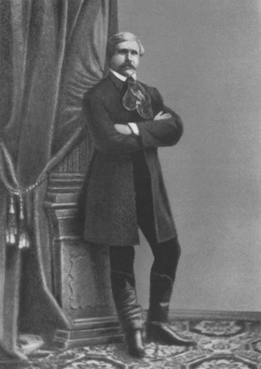
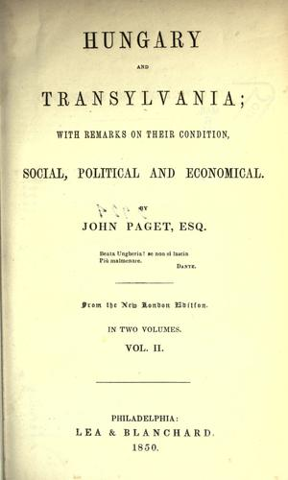
John
Paget
Notes:
But of the many British travellers who had visited Hungary in the 1830s, Dr John Paget is the best known. In 1837 he married Polixéna Wesselényi; he was an aide-de-camp to a Polish general in command of the Hungarian army during the 1848 revolution; and had to return to Britain in 1849, but he again moved to Transylvania in 1853. He died there and is buried in Kolozsvár. "I am deeply interested in the welfare of Hungary, and I have thought that one great means of promoting it would be to extend the knowledge of that country in the west of Europe, and more especially in England," he wrote in his book, published in London in 1839 - the best known publication dedicated to Hungary in this period. During this period English public opinion was acclaiming the Hungarians as the martyrs of liberty, democracy and progress, whose war of liberation against Imperial tyranny had been despite the unsuccessful ending, a fine achievement. British travellers, political agents, and such politicians as had studied the Hungarian question, were all convinced of Hungary's historical importance in the Danubian Basin. Some like J A Blackwell, went so far as to declare that, in her own interest, England needed an independent Hungary.

Slide 12
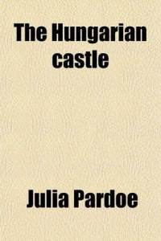
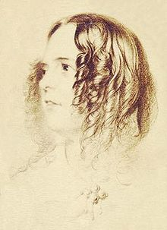
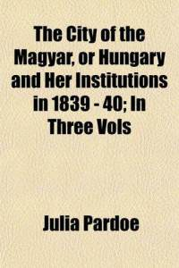
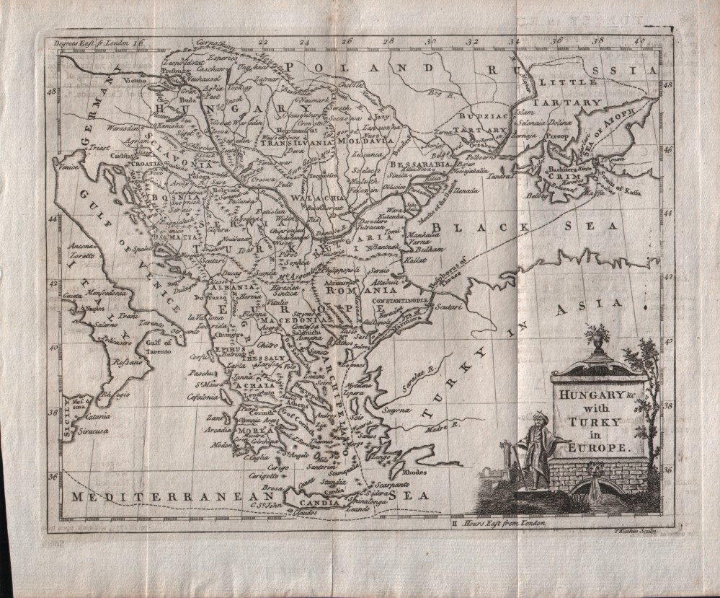
Julia Pardoe
Notes:
In addition to Paget and Blackwell, this can be understood from the writings of Quin, Urquhart, Mac Gregor and Miss Julia Pardoe – poet, novelist, historian and traveller. She travelled to Constantinople in 1836 and her first book on Hungary was published in 1840, the first to describe the country’s institutions and to feature interviews with many famous people. She is credited as being one of the originators of the positive view of Hungary held by many English people in the 19th Century.

Slide 13
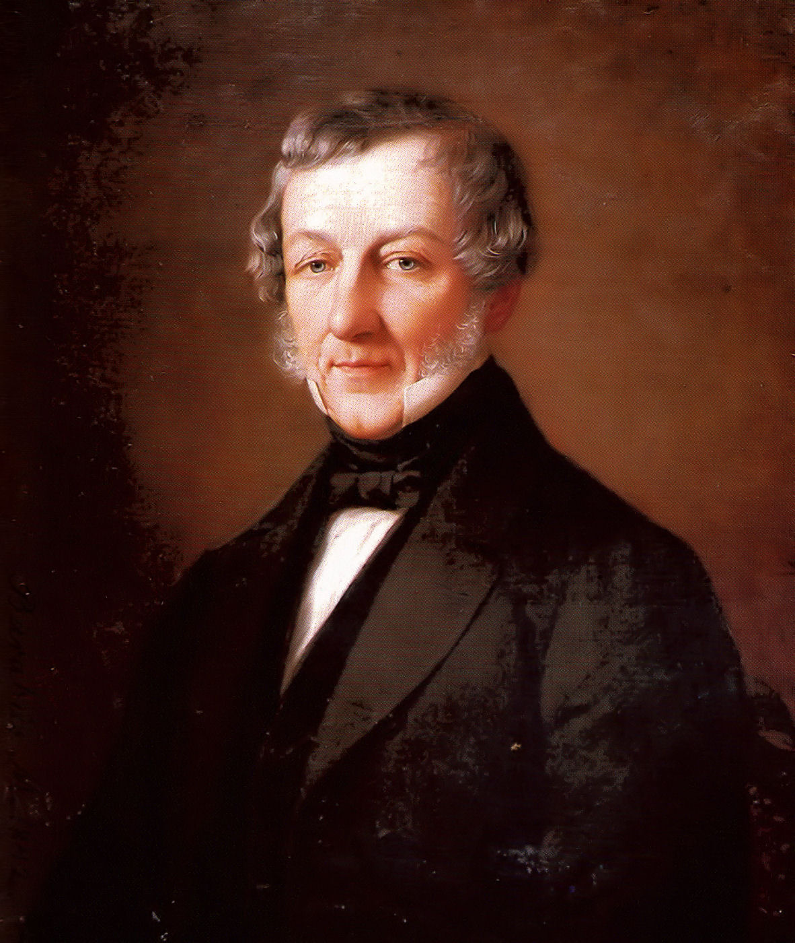
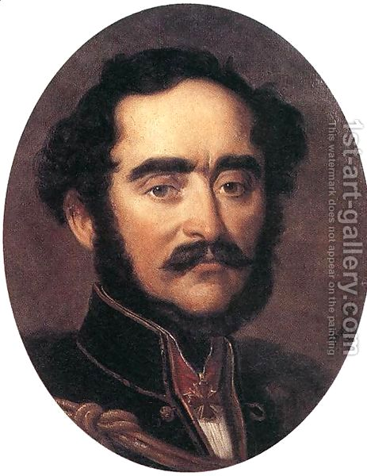
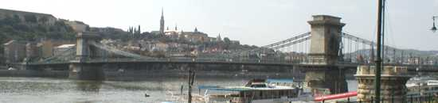
William Tierney Clark
Notes:
Around the same time we come across the English engineer William Tierney Clark, who in 1839 planned the Chain Bridge, which was built by the Scot Adam Clark, no relation. The bridge, financed by Count Széchenyi, is just one well-known example of technical contacts of that era.

Slide 14
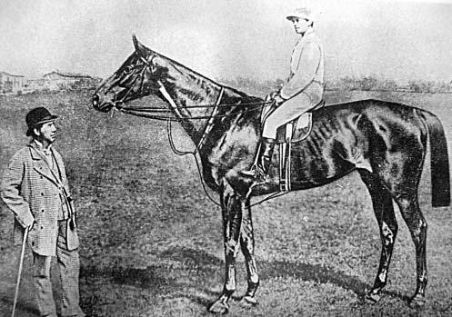
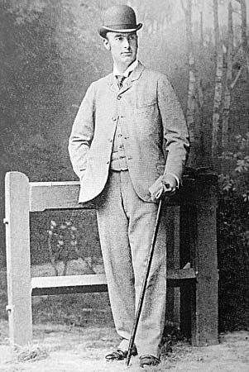
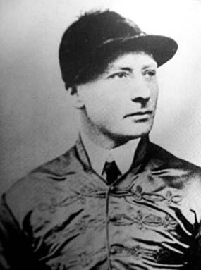
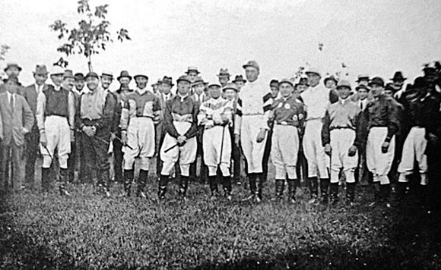
Jockeys and Trainers
Notes:
George Williamson was one of England’s leading steeplechase jockeys – he was a regular visitor to Hungary for around 15 years and owned a house in the Alag training centre. His most significant wins were in the Velká Pardubická, Continental Europe’s biggest steeplechase in 1890 and 1893 - the only jockey to have won this and the Grand National. One season he appeared on the Budapest racecourse with Daisy, Countess of Warwick, the former mistress of King Edward VII, on his arm. (She was of “Daisy, Daisy” fame.) However, she soon left him for Count Elemér Batthyány, President of the Hungarian Jockey Club. Batthyány then disposed of Williamson by ensuring that he was given no rides that season. Williamson’s story was far from untypical. For much of the 19th Century Hungarian race meetings were almost wholly dominated by English jockeys and trainers. In 1906, the British Consul reported that the only English people present in any numbers in Hungary were “trainers, jockeys, and governesses”. Robert Hesp was one of the first English trainers, arriving here around 1844. He became involved in the 1848 Revolution and may even have been a double agent. He trained the most famous horse in Hungarian history, Kincsem, who raced 54 times and always won. Kincsem retired to stud but died relatively young in 1887; Hesp apparently lost the will to live and died a month later. John Reeves was the leading English trainer in Hungary from 1867-1922 and is buried at Alag. Tata was founded as a racing community in the 1860s by Count Miklós Esterházy and up to 20 English families were living there until training ceased in 1922. A few of the English, including Harry Milne who is buried there, stayed on in retirement. During the 1WW a commission of the Red Cross appeared in Hungary and asked to see the English trainers to check that they were being treated correctly. The first attempts to meet failed because the trainers were too busy going to the races. When they did meet, the trainers had a serious complaint — they were unable to obtain any decent Scotch whisky. The last active trainer died in 1954.

Slide 15
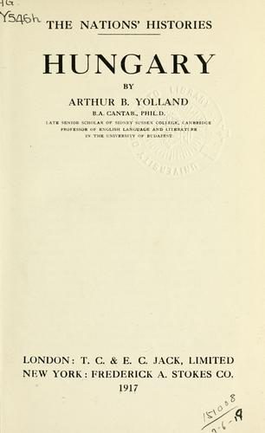
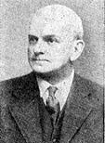
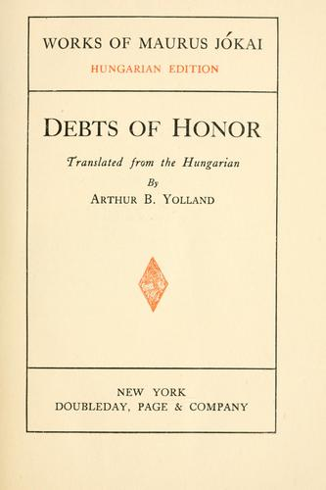
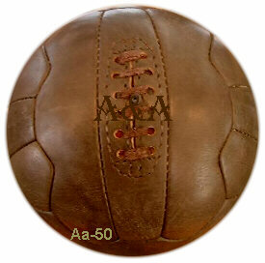
Arthur
Yolland
Notes:
This is Arthur Yolland, a literary historian. He is here today because he is one of two Englishmen, the other being Thomas Ashtone, who starred in Hungary’s first international football team in 1897 between the Budapest Gymnastics Club and the Vienna Cricket and Football Club. Hungary lost 2-0, a respectable result – there were 8 English players on the Viennese side. Yolland spent much time in Hungary; was also twice winner of the National Tennis Championships; and died on 12 November 1956.

Slide 16
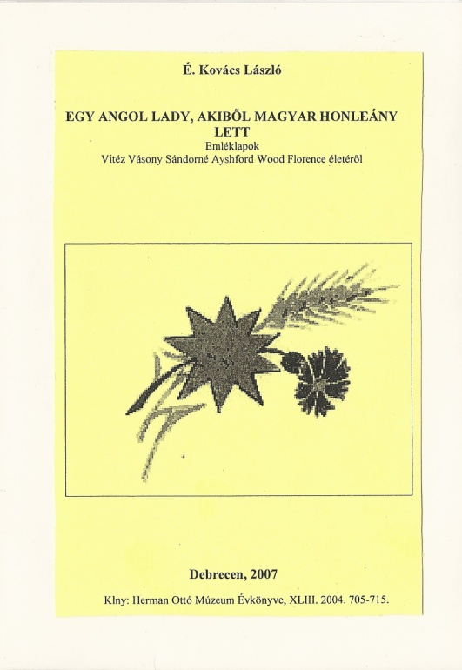
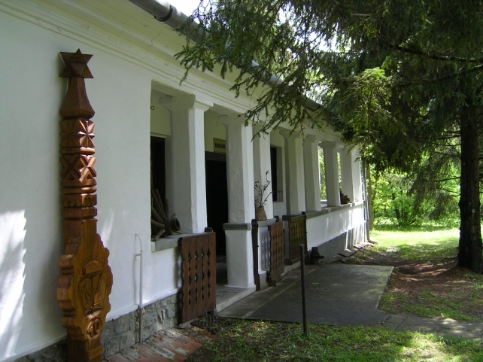
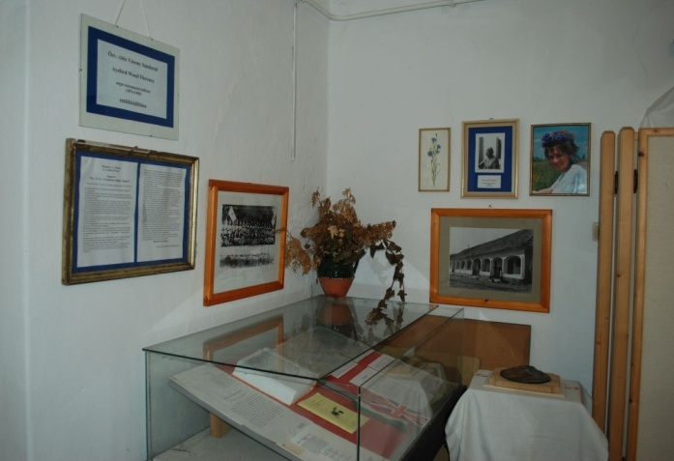
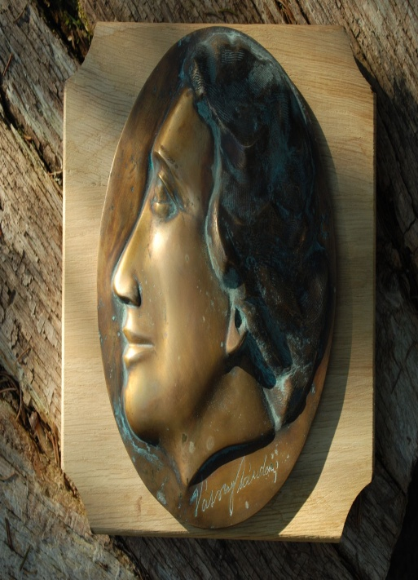
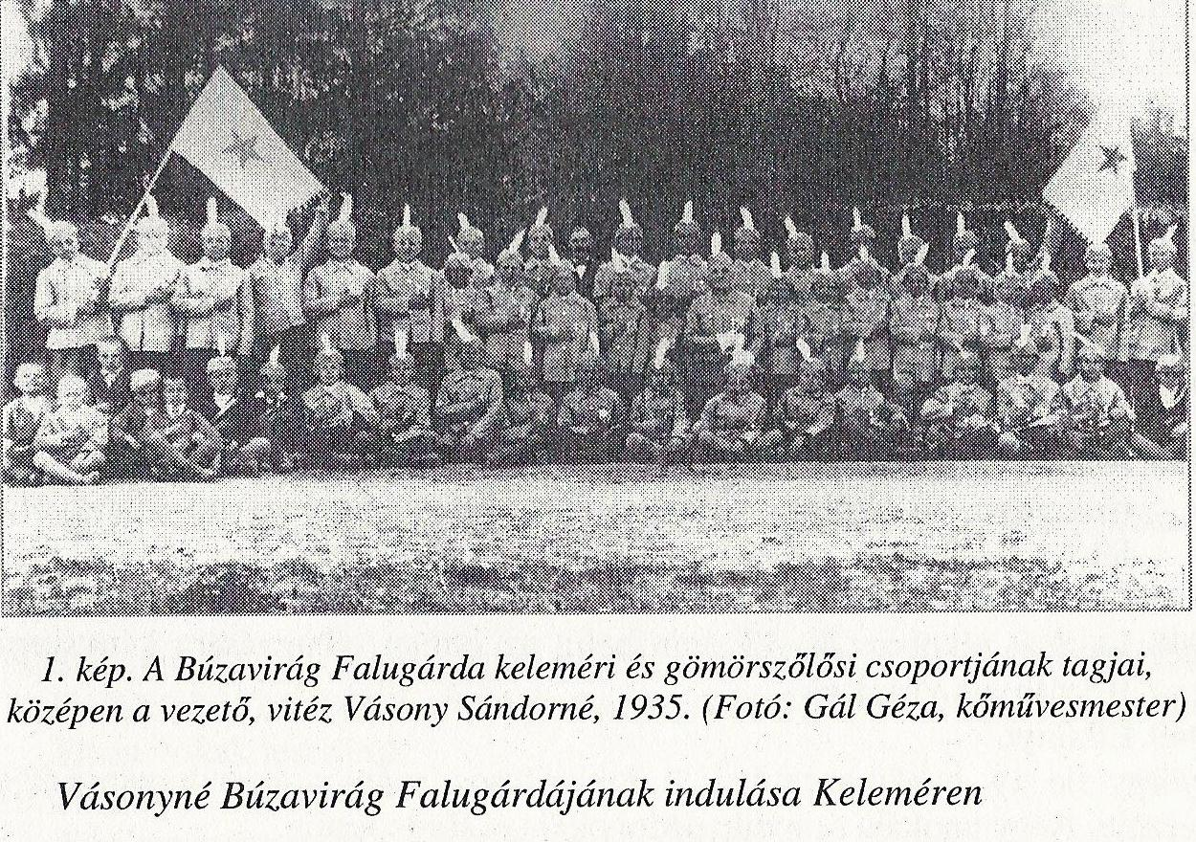
Florence Ayshford Wood
Notes:
Florence Ayshford Wood, a lady with “rosy Devonshire cheeks” came to Budapest in the early 20th Century to visit friends; helped the children of the gentry to learn English; and in 1912 married a nobleman, Sandor Vasony – he died in 1924 leaving a son, whom she felt should be brought up in Hungary. They visited friends in Gomorszolos every school holiday and she decided to help underprivileged children from the Borsod region. Over 15 years, with the expenditure of much of her income she taught the children songs, games and behaviour; established a library; gave them clothes, food, toys and first-aid; and arranged for some to visit Budapest by train. The children were known as the “Cornflower Village Guards”. But by the end of the 1930’s, for reasons that are unclear, the local administration banned her from the area. She survived the 2WW and died in 1949.

Slide 17
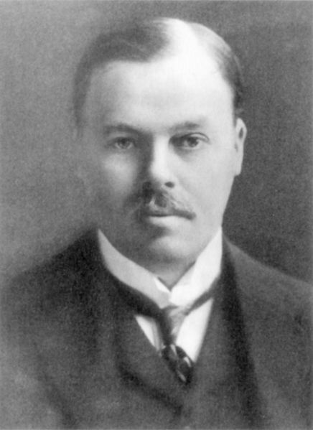
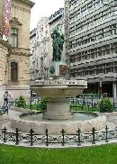


Lord Rothermere
Notes:
More controversially, Harold Harmsworth, Lord and then 1st Viscount and Baron Rothermere, was a strong supporter of the revision of the Treaty of Trianon in favour of Hungary. It is said his motivation was to a large extent due to the seductress Princess Stephanie Julianne von Hohenlohe, later one of Hitler’s spies, who received astonishing amounts of money from him. In 1927 he was allegedly offered the Hungarian Crown – he declined but bought estates in Hungary in case the UK should fall to a Soviet invasion. As proprietor of the “Daily Mail”, he continued to use his position to support Hungary. In 1928 his son Esmond Cecil represented him in Budapest where he received an ecstatic welcome and according to “Time” magazine was “mobbed by hearty wenches in bright peasant costumes”. This statue to Lord Harmsworth near Kalvin Ter dates from 1929.

Slide 18




Scouting
Notes:
Scouting was of course intensively popular right up until Communist times. The Chief Scout Lord Baden Powell visited Godollo for the 1933 Jamboree and can be seen here with Count Pál Teleki, Prime Minister in the early 1920s and between 1939 and 1941 (when he committed suicide). Teleki was Chief Scout in the 1920s and Camp Chief in Godollo.

Slide 19


Patrick Leigh Fermor
Notes:
This is the only one of my case studies still alive. In December 1933 an 18-year-old Patrick Leigh Fermor put on a pair of hobnail boots and a second-hand greatcoat, gathered up his rucksack and very little money and left London for Rotterdam from where he planned to walk to Istanbul. “Between the Woods and the Water” covers his time in Hungary. He was perhaps the archetypal budget traveller. Peasants gave him baskets of eggs and swigs of raspberry palinka. Small-town mayors found him beds. The lingering nobility put him up in their castles, invited him to balls and lent him their horses. Now 95, many consider him Britain’s greatest living travel writer.

Slide 20



Shakespeare
Notes:
This last case is a bit fraudulent. Shakespeare almost certainly never visited Hungary. But he and several of his contemporaries mention Hungary in their work. And he has become tremendously popular here, with Hungary’s 3 greatest 19th-century poets - Petőfi, Arany and Vörösmarty - producing translations used to this day. And since 23 April is celebrated as his birthday as well as St George’s Day, he is with us in spirit right now. Sure you know where this statue can be found, in Budapest.

Slide 21

"There is a forgotten, nay almost forbidden word,
which means more to me than any other.
That word is ENGLAND.“ (Churchill)

